Slide 2
What is Group Project ?

Slide 3

What is Group Project ?

Slide 4

Group Members:-
Siddhartha Kumar – 12104975
Yogendra Singh Rajpoot – 12109473
Nitish Kumar - 12113852
What is Group Project ?
Faculty: Dr. Dipen Saini

Slide 5

Sentiment Analysis Project
Faculty: Dr. Dipen Saini
Group Members:-
Siddhartha Kumar – 12104975
Yogendra Singh Rajpoot – 12109473
Nitish Kumar - 12113852

Slide 6

Sentiment Analysis Project
Group Members:-
Siddhartha Kumar – 12104975
Yogendra Singh Rajpoot – 12109473
Nitish Kumar - 12113852
Faculty: Dr. Dipen Saini

Slide 7

Sentiment Analysis On Amazon Reviews

Slide 8

Sentiment Analysis Project With NLTK and 🤗 Transformers

Slide 9

Sentiment Analysis Project With NLTK and 🤗 Transformers

Slide 10

Sentiment Analysis Project With NLTK and 🤗 Transformers
We Use Two Different techniques

Slide 11
Sentiment Analysis Project With NLTK and 🤗 Transformers
We Use Two Different techniques

Slide 12
We Use Two Different techniques

Slide 13
We Use Two Different techniques
VADER (Valence Aware Dictionary and sEntiment Reasoner) - Bag of words approach (Traditional)

Slide 14
We Use Two Different techniques
VADER (Valence Aware Dictionary and sEntiment Reasoner) - Bag of words approach (Traditional)
Roberta Pretrained Model from 🤗 Huggingface Pipeline (More Complex and accurate)

Slide 15
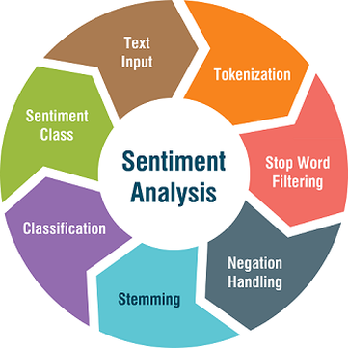
What is Sentiment Analysis?
We Use Two Different techniques
VADER (Valence Aware Dictionary and sEntiment Reasoner) - Bag of words approach (Traditional)
Roberta Pretrained Model from 🤗 Huggingface Pipeline (More Complex and accurate)

Slide 16
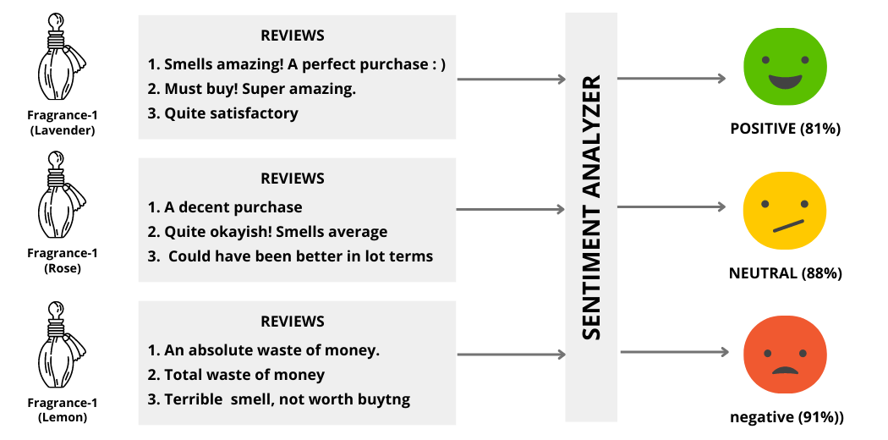
Example:
What is Sentiment Analysis?
VADER (Valence Aware Dictionary and sEntiment Reasoner) - Bag of words approach
Roberta Pretrained Model from 🤗 Huggingface Pipeline

Slide 17

Group Project 🤔
Example:
What is Sentiment Analysis?

Slide 18
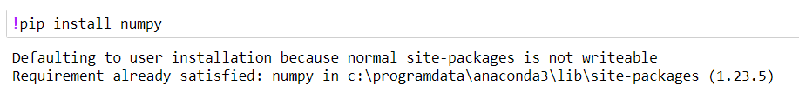
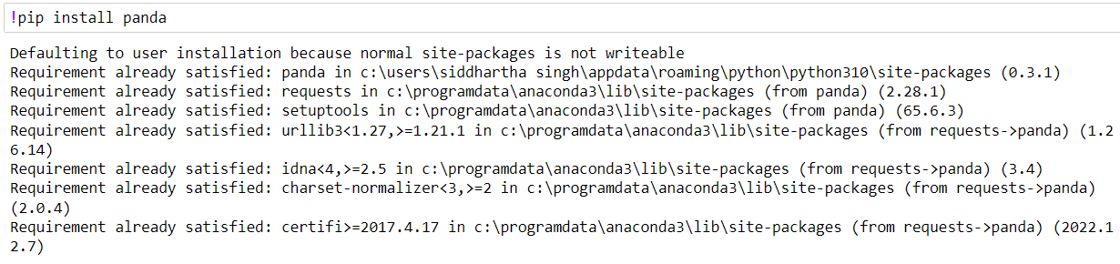
Environment Setup
Group Project 🤔
Example:
Installing Numpy
Installing Pandas

Slide 19
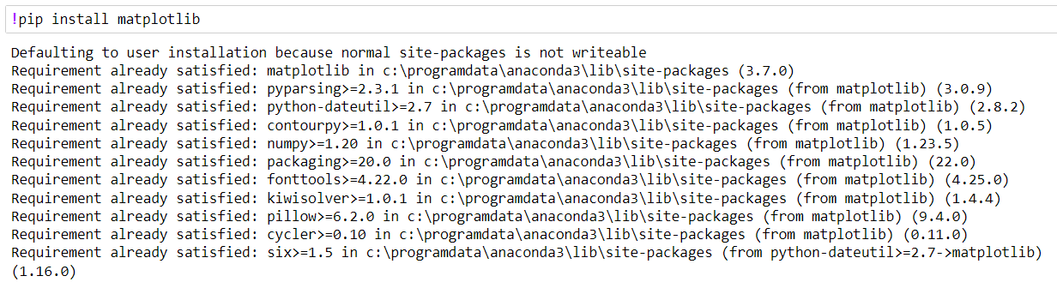
Environment Setup
Installing Numpy
Installing matplotlib
Installing Pandas

Slide 20
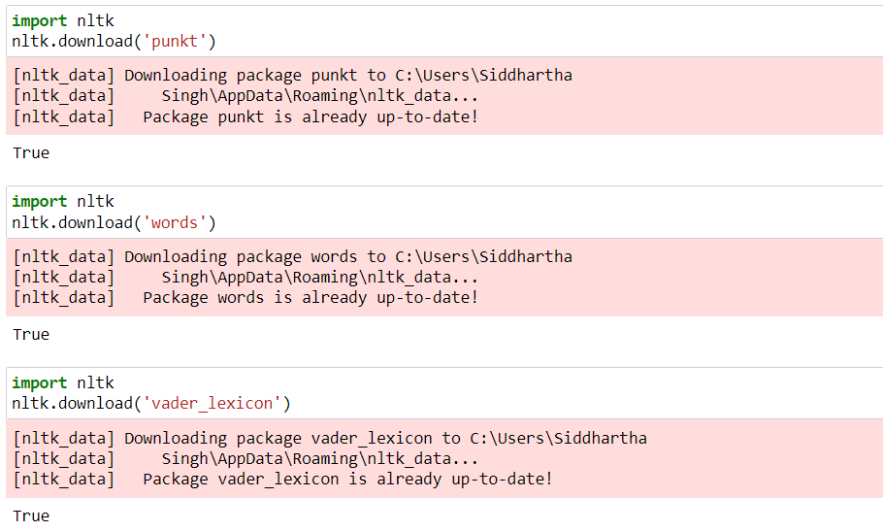
Environment Setup
Installing Numpy
Installing matplotlib
Installing Pandas
Installing NLTK (Natural Language ToolKit)

Slide 21
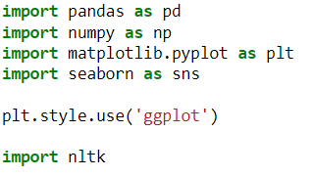
Environment Setup
Installing NLTK (Natural Language ToolKit)
Installing matplotlib
Importing Required Library
Implimentation

Slide 22

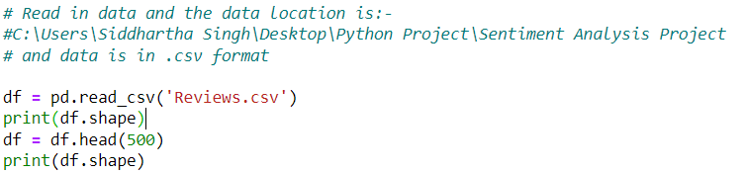
Implimentation
Importing Required Library
Output
Installing NLTK (Natural Language ToolKit)
Reading Data From File i.e in .csv and we select 500 rows of data out of 568454
Environment Setup

Slide 23
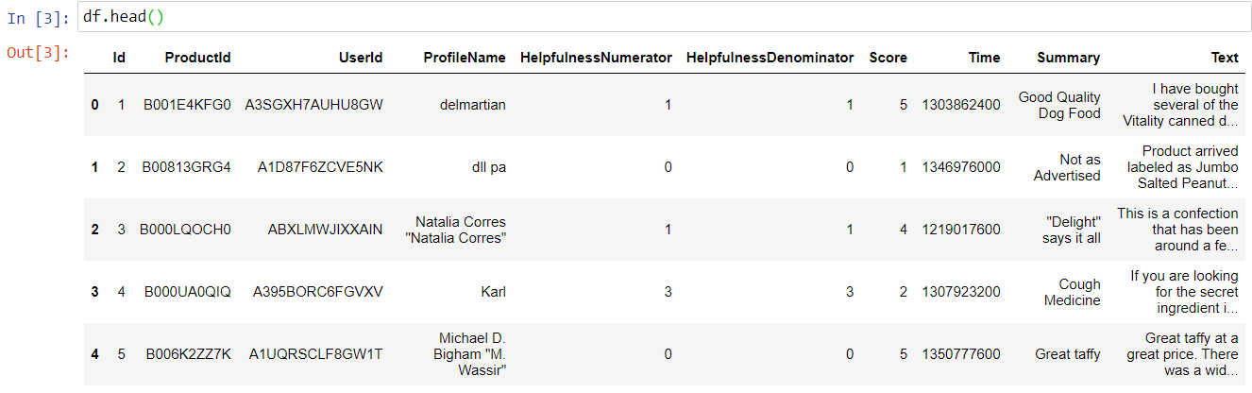
Implimentation
Reading Data From File i.e in .csv and we select 500 rows of data out of 568454
Output
Importing Required Library

Slide 24
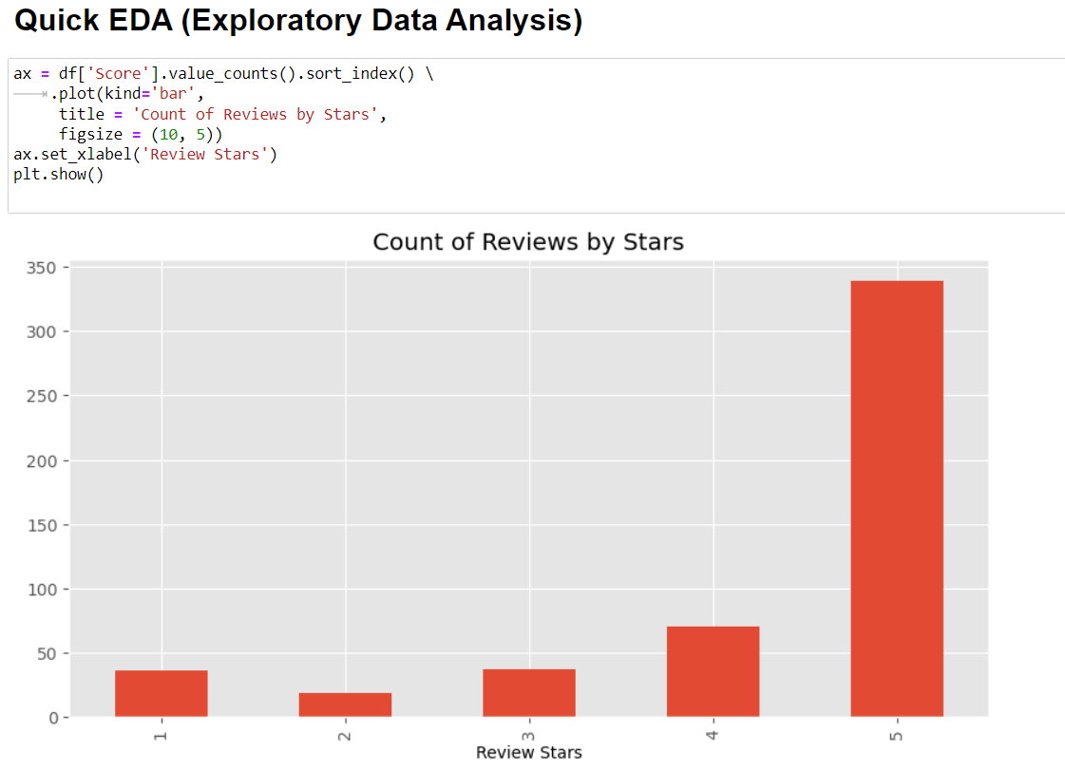
Implimentation
Use dataframe to show first 500 rows of data
Output
Reading Data From File i.e in .csv and we select 500 rows of data out of 568454

Slide 25
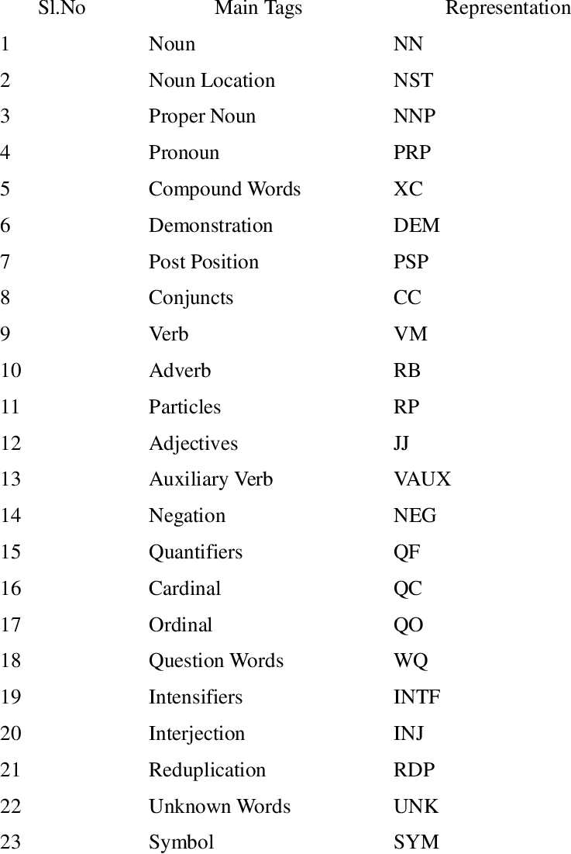

Implimentation
Use dataframe to show first 500 rows of data
Abbreviation

Slide 26
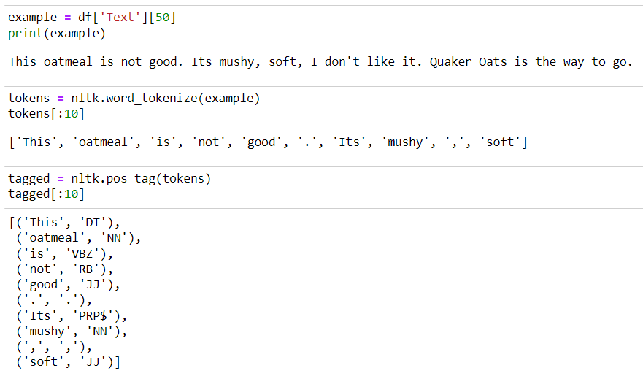
Abbreviation
Implimentation

Slide 27

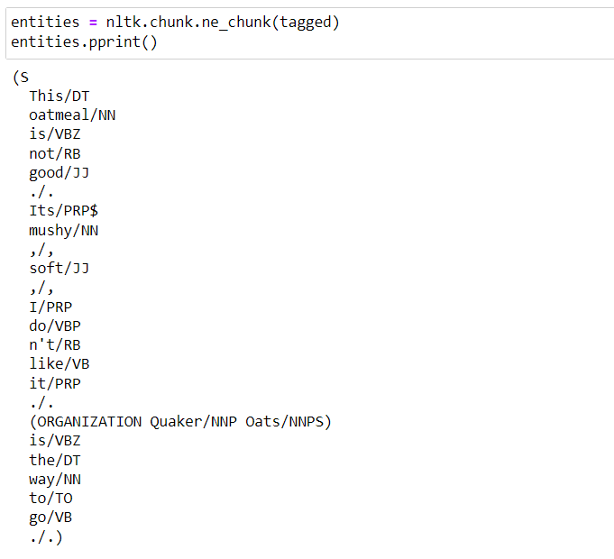
Implimentation
Abbreviation

Slide 28

Implimentation
We will use NLTK's SentimentIntensityAnalyzer to get the negative/Neutral/Positive scores of the text.
This uses a "Bag of words" approach:
Stop words are removed
Each word is scored and combined to a total score.

Slide 29
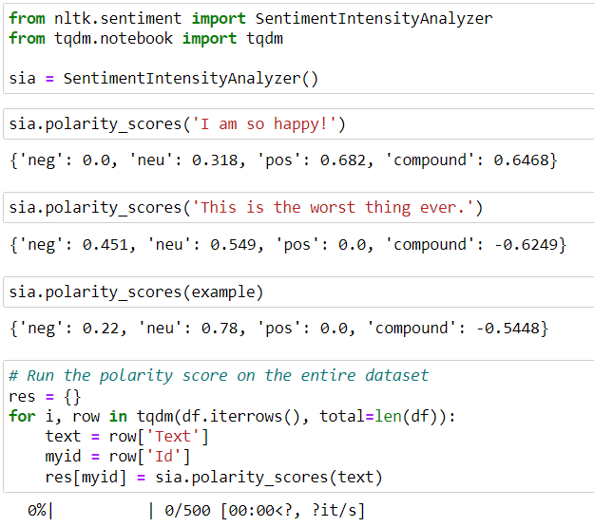
Implimentation
Step 1. VADER Seniment Scoring
We will use NLTK's SentimentIntensityAnalyzer to get the negative/Neutral/Positive scores of the text.
This uses a "Bag of words" approach:
Stop words are removed
Each word is scored and combined to a total score.
Import Library & Impliment

Slide 30
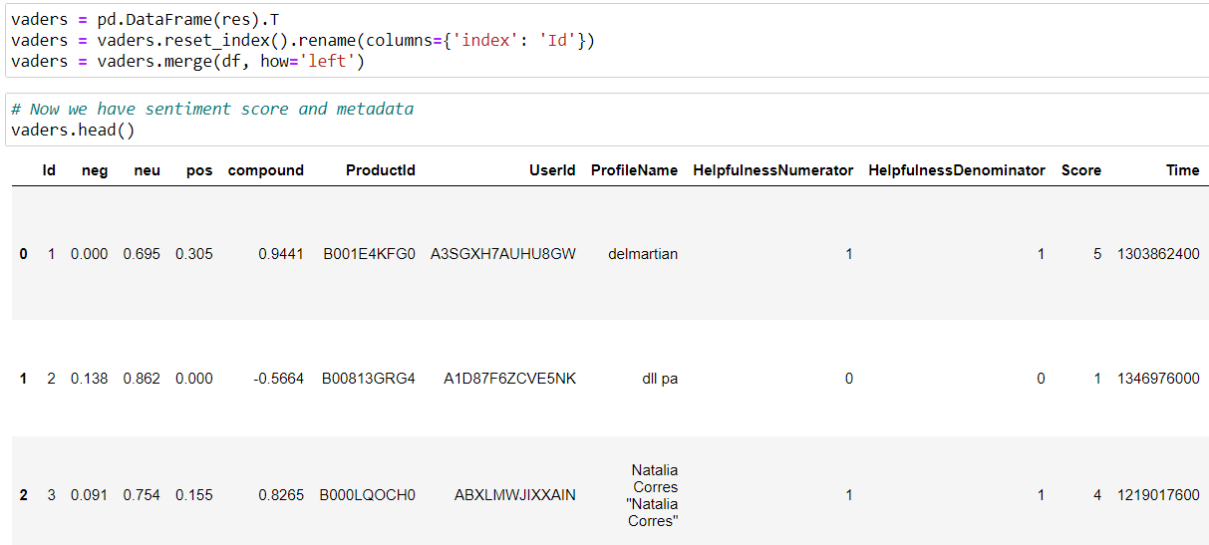
Implimentation
Import Library & Impliment
We will use NLTK's SentimentIntensityAnalyzer to get the negative/Neutral/Positive scores of the text.
This uses a "Bag of words" approach:
Stop words are removed
Each word is scored and combined to a total score.
Step 1. VADER Seniment Scoring

Slide 31
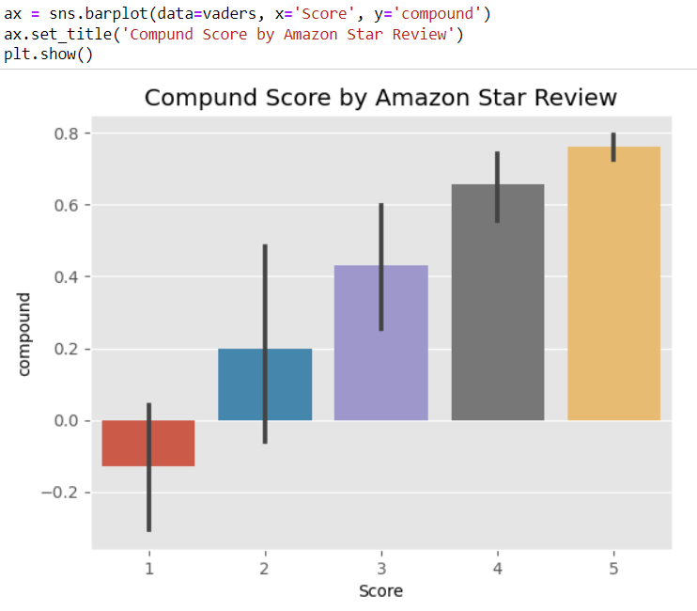
Implimentation
Import Library & Impliment

Slide 32
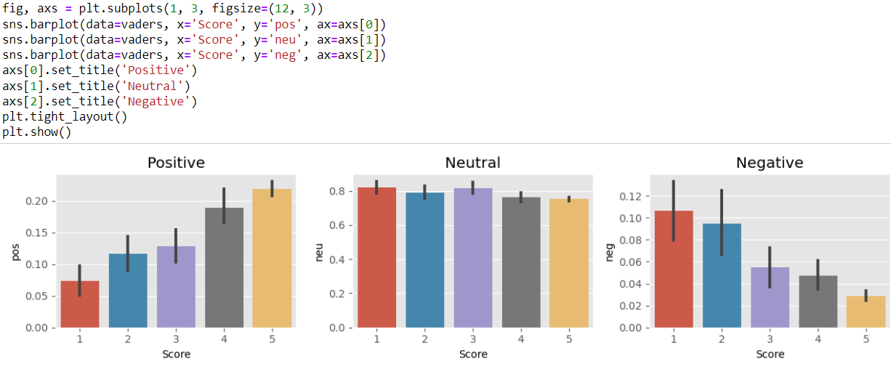
Implimentation
Step 2. Plot VADER Result

Slide 33

Implimentation
Step 2. Plot VADER Result
Use a model trained of a large corpus of data.
Transformer model accounts for the words but also the context related to other words.
Step 3. Roberta Pretrained Model

Slide 34
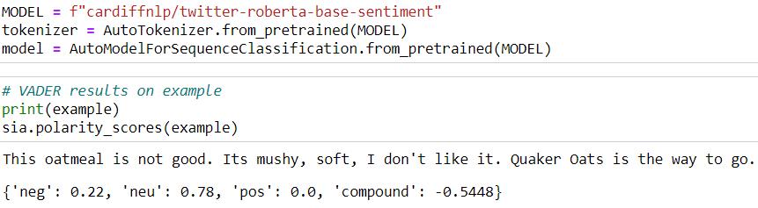

Implimentation
Implimenting
Step 3. Roberta Pretrained Model
Importing Library
Use a model trained of a large corpus of data.
Transformer model accounts for the words but also the context related to other words.
Step 2. Plot VADER Result

Slide 35
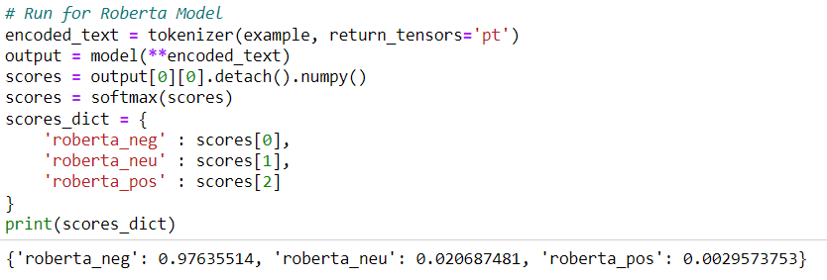
Implimentation
Importing Library
Use a model trained of a large corpus of data.
Transformer model accounts for the words but also the context related to other words.
Implimenting
Step 3. Roberta Pretrained Model

Slide 36
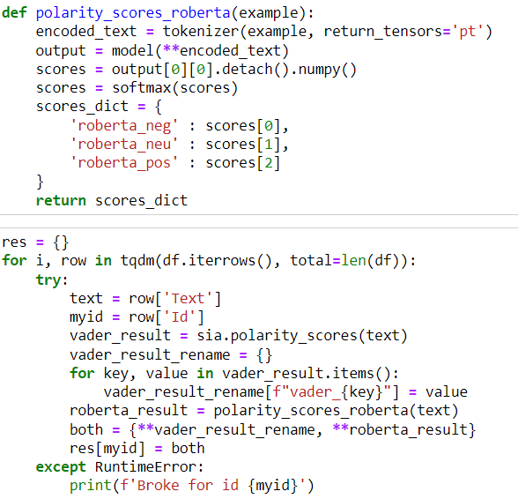
Implimentation
Implimenting
Importing Library

Slide 37
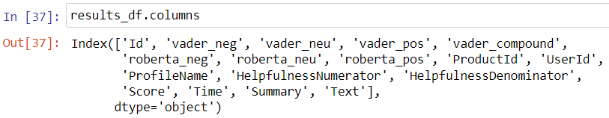
Implimentation
Compare Scores Between Models

Slide 38
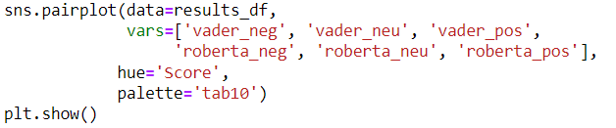
Implimentation
Compare Scores Between Models
Step 4. Combine and Compare

Slide 39
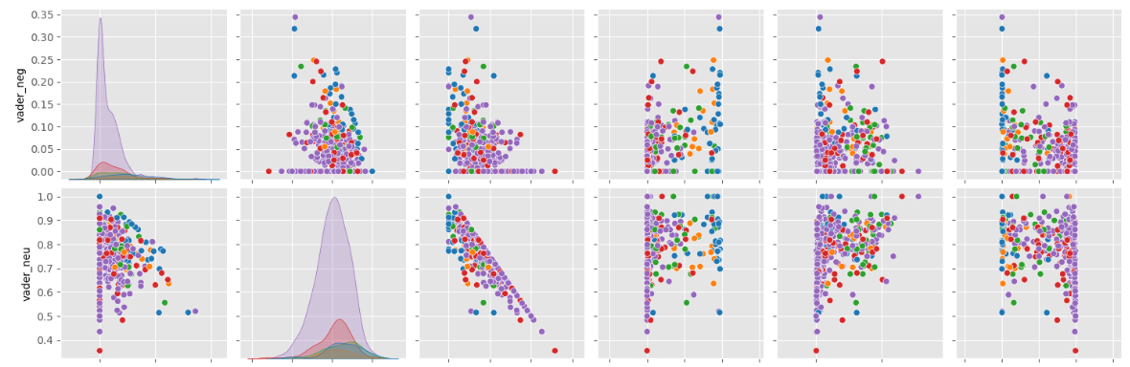
Implimentation
Step 4. Combine and Compare
Compare Scores Between Models

Slide 40
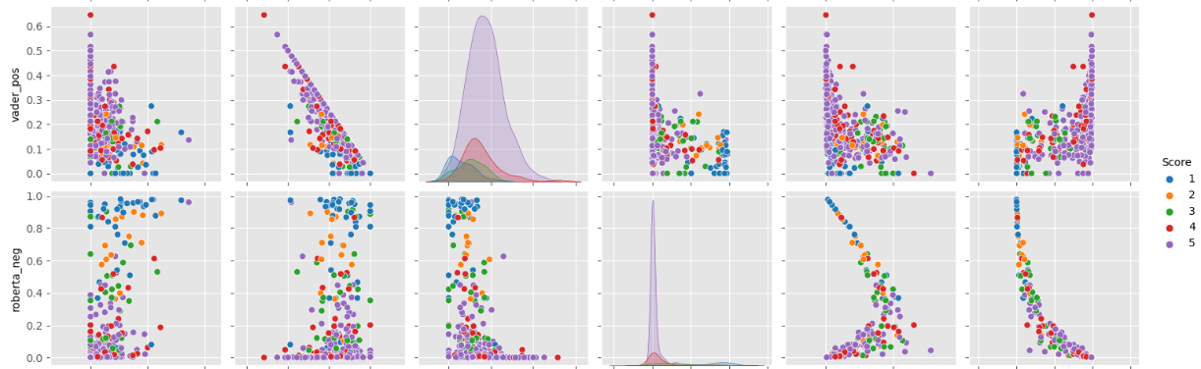
Implimentation
Combine and Compare
Step 4. Combine and Compare

Slide 41
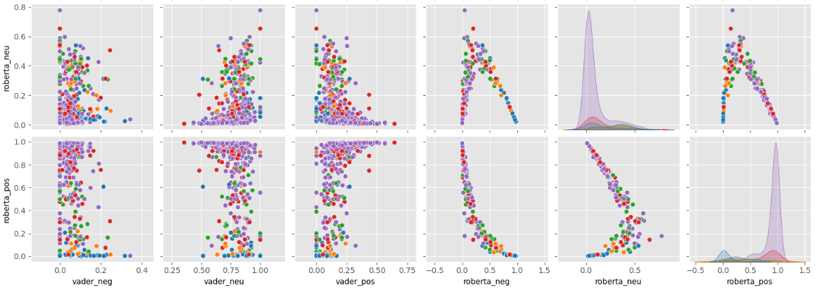
Implimentation
Combine and Compare

Slide 42
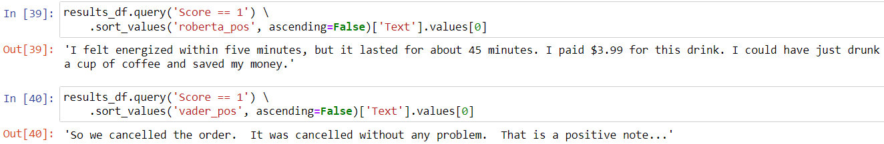
Implimentation
Step 5. Review Examples:
Positive 1-Star and Negative 5-Star Reviews
Lets look at some examples where the model scoring and review score differ the most.
Combine and Compare

Slide 43
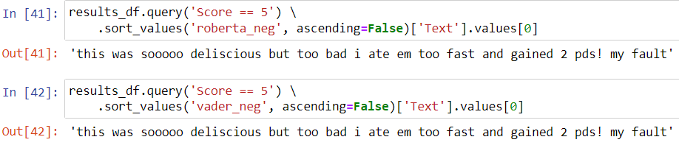
Implimentation
Step 5. Review Examples:
Positive 1-Star and Negative 5-Star Reviews
Lets look at some examples where the model scoring and review score differ the most.
Negative sentiment 5-Star view

Slide 44

Implimentation
Negative sentiment 5-Star view
Step 5. Review Examples:
Positive 1-Star and Negative 5-Star Reviews
Lets look at some examples where the model scoring and review score differ the most.
Step 6. Extra: The Transformers Pipeline
Quick & easy way to run sentiment predictions

Slide 45
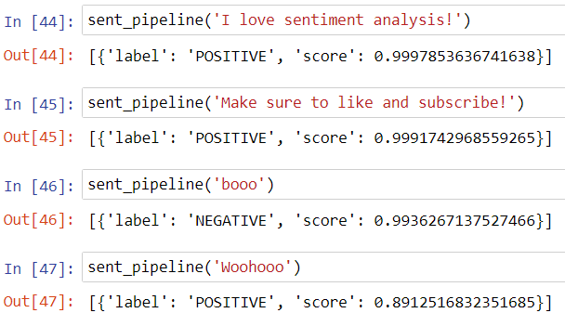
Implimentation
Step 6. Extra: The Transformers Pipeline
Quick & easy way to run sentiment predictions
Negative sentiment 5-Star view

Slide 46

Implimentation
Step 6. Extra: The Transformers Pipeline
Quick & easy way to run sentiment predictions

Slide 47
Implimentation

